Slide 1
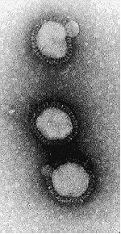
INFLUENZA VIRUS
2002
INFLUENZA VIRUS
CDC WEBSITE
http://www.cdc.gov/ncidod/diseases/flu/fluinfo.htm

Slide 2
‘FLU’
True influenza
influenza virus A or influenza virus B (or influenza virus C infections - much milder)
Febrile respiratory disease with systemic symptoms caused by a variety of other organisms often called ‘flu’

Slide 3
THE IMPACT OF INFLUENZA PANDEMICS
Deaths:

Slide 4
THE IMPACT OF INFLUENZA
1972-1994 (19 influenza seasons)
>20,000 US deaths in 11 seasons
>40,000 US deaths in 6 of these
many more hospitalizations (~110,000 per year)

Slide 5
THE IMPACT OF INFLUENZA
recently some increase in morbidity and mortality - possible factors?
more elderly people
CF patients live longer
more high risk neonates
more immunosuppressed patients

Slide 6
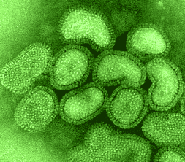
ORTHOMYXOVIRUSES
single-stranded RNA viruses of the family Orthomyxoviridae.
The core nucleoproteins are used to distinguish the 3 types of influenza viruses: A, B, and C.
http://www.uct.ac.za/depts/mmi/stannard/fluvirus.html

Slide 7
PATHOGENESIS
Hemagglutinin and neuraminidase are critical for virulence, and they are major targets for the neutralizing antibodies of acquired immunity to influenza.
Hemagglutinin binds to respiratory epithelial cells, allowing cellular infection.
Neuraminidase cleaves the bond that holds newly replicated virions to the cell surface, permitting the infection to spread.

Slide 8
Major typing of influenza A occurs through identification of both H and N proteins. Nine H and 16 N types have been identified.
All hemagglutinins and neuraminidases infect wild waterfowl, and the various combinations of H and N yield 144 potential subtypes of influenza.

Slide 9
ANTIGENIC DRIFT
HA and NA accumulate mutations
RNA virus
immune response no longer protects fully
sporadic outbreaks, limited epidemics

Slide 10
ANTIGENIC SHIFT
“new” HA or NA proteins
pre-existing antibodies do not protect
may get pandemics

Slide 11
where do “new” HA and NA come from?
13 types HA
9 types NA
all circulate in birds
pigs
avian and human

Slide 12
where do “new” HA and NA come from?

Slide 13
Three major influenza pandemics have been recorded:
The Spanish influenza pandemic of 1918 (H1N1)
The pandemic of 1957 (H2N2)
The pandemic of 1968 (H3N2)
Smaller outbreaks occurred in 1947, 1976, 1977, and 2009.

Slide 14
why do we not have influenza B pandemics?
so far no shifts have been recorded
no animal reservoir known

Slide 15
TRANSMISSION
AEROSOL
100,000 TO 1,000,000 VIRIONS PER DROPLET
18-72 HR INCUBATION

Slide 16
Transmission of influenza from poultry or pigs to humans appears to occur predominantly as a result of direct contact with infected animals.
The risk is especially high during slaughter and preparation for consumption; eating properly cooked meat poses no risk.
Avian influenza can also be spread through exposure to water and surfaces contaminated by bird droppings.
Influenza viruses spread from human to human via aerosols created when an infected individual coughs or sneezes.
If not neutralized by secretory antibodies, the virus invades airway and respiratory tract cells.

Slide 17
VIRAL SHEDDING
Viral shedding occurs at the onset of symptoms or just before the onset of illness (0-24 hours).
Shedding continues for 5-10 days.
Young children may shed virus longer, placing others at risk for contracting infection.
In highly immunocompromised persons, shedding may persist for weeks to months

Slide 18
SYMPTOMS
FEVER
HEADACHE
MYALGIA
COUGH
RHINITIS
OCULAR SYMPTOMS

Slide 19
CLINICAL FINDINGS
SEVERITY
VERY YOUNG
ELDERLY
IMMUNO-COMPROMISED
HEART OR LUNG DISEASE

Slide 20
Risk factors or features that should raise the index of suspicion of H5N1 avian influenza include the following :
Recent (within the preceding 2 weeks) travel to or location in a country with known avian influenza cases in animals or humans
Unusual comorbidities such as encephalopathy or diarrhea
History of exposure to birds, especially living in close proximity to birds, contact with sick or dying birds, or consumption of incompletely cooked bird meat
History of exposure to individuals with known avian influenza, especially family, or to sick people in a country with known human cases of avian influenza

Slide 21
DIFFERENTIAL DIAGNOSIS
Accurately diagnosing influenza A or B infection solely on the basis of clinical criteria is difficult because of the overlapping symptoms caused by the various viruses associated with upper respiratory tract infection (URI).
Viruses that may initially cause influenzalike symptoms include adenoviruses, enteroviruses, and paramyxoviruses.

Slide 22
LABORATORY INVESTIGATIONS
The criterion standard for confirming influenza virus infection is reverse transcription-polymerase chain reaction (RT-PCR) or viral culture of nasopharyngeal or throat secretions.
Rapid influenza diagnostic tests are available
Complete blood count; leukopenia, relative lymphopenia,thromboytopenia

Slide 23
COMPLICATIONS
primary influenza pneumonia,
secondary bacterial pneumonia,
pneumonia due to unusual pathogens or in immunocompromised hosts,
exacerbations of chronic pulmonary diseases.

Slide 24
NON-PULMONARY COMPLICATIONS
myositis (rare, > in children, > with type B)
Reyes syndrome
Guillain barre syndrome

Slide 25
MORTALITY
MAJOR CAUSES OF INFLUENZA VIRUS- ASSOCIATED DEATH
BACTERIAL PNEUMONIA
CARDIAC FAILURE
90% OF DEATHS IN THOSE OVER 65 YEARS OF AGE

Slide 26
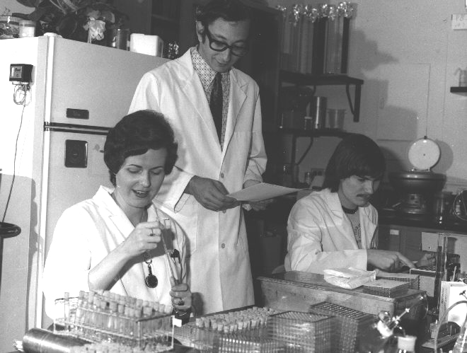
SURVEILLANCE
CDC/Katherine Lord

Slide 27
VACCINE
‘BEST GUESS’ OF MAIN ANTIGENIC TYPES
CURRENTLY
type A - H1N1
type A - H3N2
type B
each year choose which variant of each subtype is the best to use for optimal protection

Slide 28
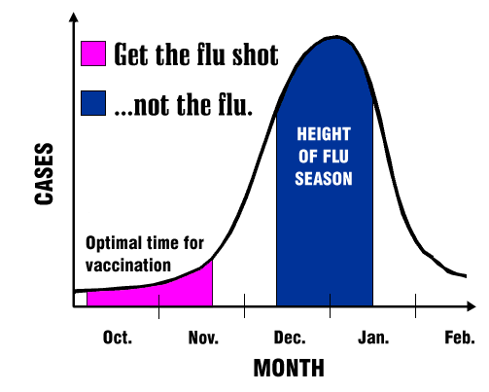
CDC

Slide 29
RECOMMENDATIONS
Persons at High Risk for Influenza-Related Complications
· $ 65 years
· residents of nursing homes and other chronic-care facilities
· adults/children who have chronic pulmonary or cardiovascular disorders, including asthma
· adults/children who have required regular medical follow-up or hospitalization during the last year because of chronic metabolic diseases (including diabetes mellitus), renal dysfunction, hemoglobinopathies, or immunosuppression (including immunosuppression caused by medications)

Slide 30
RECOMMENDATIONS
Persons at High Risk for Influenza-Related Complications
· children and teenagers (6 mths to 18 yrs) receiving long-term aspirin therapy - might be at risk for developing Reye syndrome after influenza
· women who will be in the 2nd or 3rd trimester of pregnancy during the influenza season.

Slide 31
RECOMMENDATIONS
Persons Who Can Transmit Influenza to Those at High Risk
Persons who are clinically or subclinically infected can transmit influenza virus to persons at high risk for complications from influenza.

Slide 32
THOSE LIKELY TO TRANSMIT INFLUENZA
· physicians, nurses, and other personnel in both hospital and outpatient-care settings
· employees of nursing homes and chronic-care facilities who have contact with patients or residents
· employees of assisted living and other residences for persons in high-risk groups
· persons who provide home care to persons in high-risk groups
· household members (including children) of persons in high-risk groups.

Slide 33
RECOMMENDATIONS
Children from 0-23 mths are at increased risk for hospitalization from influenza, vaccination is encouraged for their household contacts and out-of-home caretakers, particularly for contacts of children aged 0–5 months because influenza vaccines have not been approved for use among children aged <6 months.

Slide 34
RECOMMENDATIONS
others, including travellers and the general population may wish to be vaccinated

Slide 35
PREVENTION - DRUGS
RIMANTADINE (M2)
type A only
AMANTADINE (M2)
type A only
ZANAMIVIR (NA)
types A and B, not yet approved for prevention
OSELTAMIVIR (NA)
types A and B

Slide 36
TREATMENT - DRUGS
RIMANTADINE (M2)
type A only, needs to be given early
AMANTADINE (M2)
type A only, needs to be given early
ZANAMIVIR (NA)
types A and B, needs to be given early
OSELTAMIVIR (NA)
types A and B, needs to be given early

Slide 37
OTHER TREATMENT
REST, LIQUIDS, ANTI-FEBRILE AGENTS (NO ASPIRIN FOR AGES 6MTHS-18YRS)
BE AWARE OF COMPLICATIONS AND TREAT APPROPRIATELY

Slide 38
severity of illness
animal reservoir
human pandemics
human epidemics
antigenic changes
segmented genome
amantadine, rimantidine
zanamivir
surface glycoproteins
TYPE A
++++
yes
yes
yes
shift, drift
yes
sensitive
sensitive
2
TYPE B
++
no
no
yes
drift
yes
no effect
sensitive
2
TYPE C
+
no
no
no (sporadic)
drift
yes
no effect
(1)

Slide 39
END

Slide 40
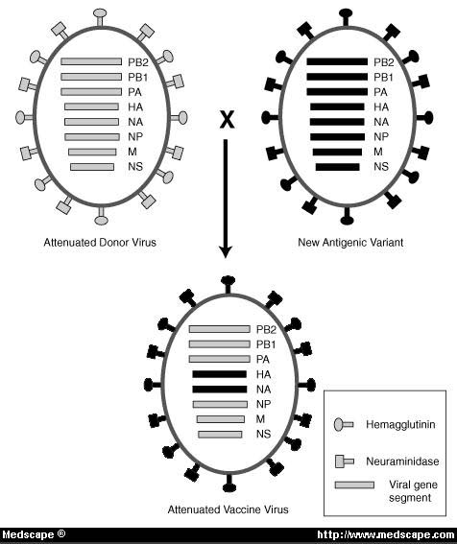
live vaccine development
adapted from
Treanor JJ Infect. Med. 15:714

